Slide 1
Understanding Transport Barriers for Older People
^{Rachel Rowlands}
^{Chief Executive Officer}
^{Age Connects Morgannwg}

Slide 2
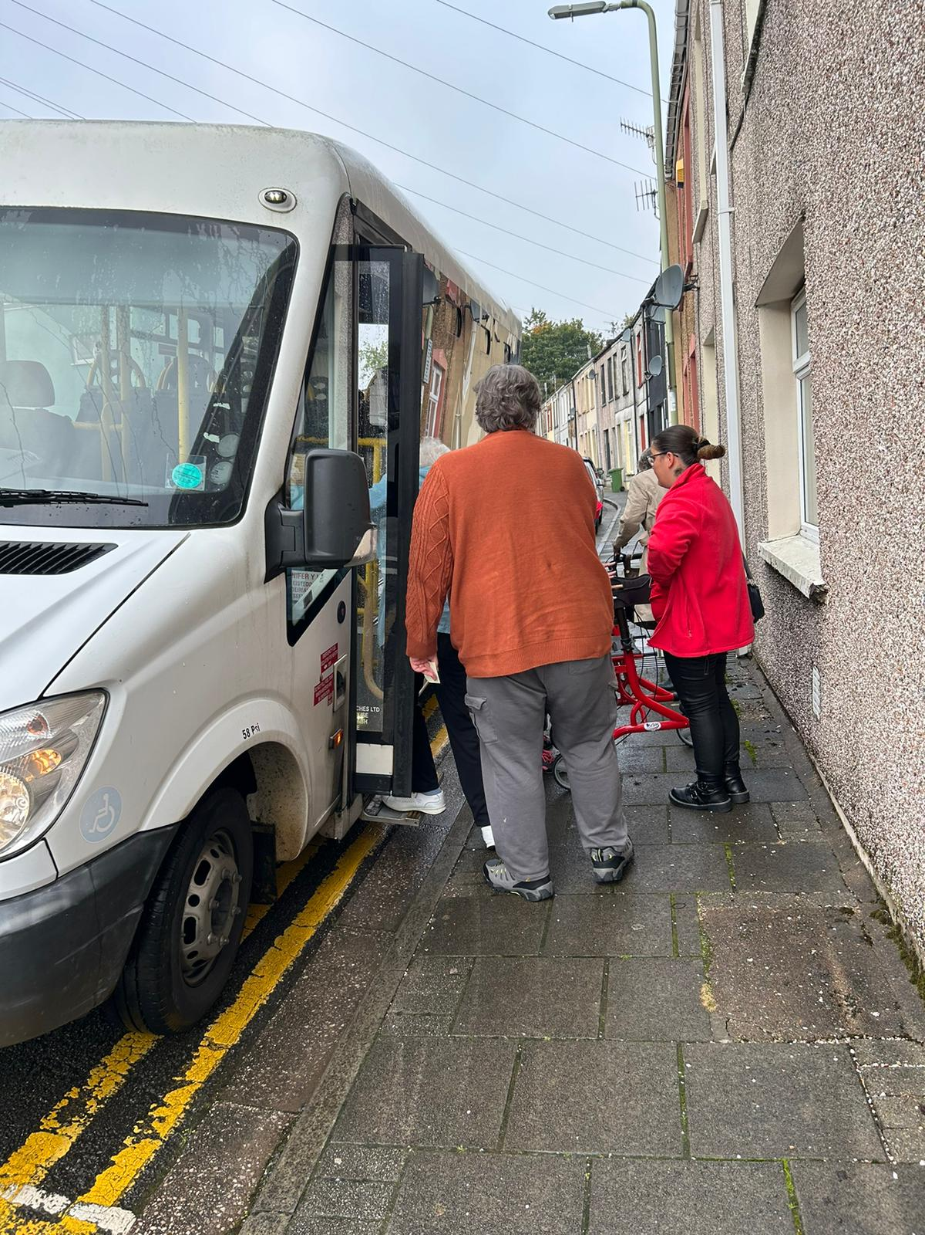
^{Why?}
^{Unprecedented demand for}
^{transport to appointments,}
^{hospital visits, and social}
^{events.}
Notes:
We know from those we support that they need help with transport for a multitude of reasons. We have taken more than 800 people to their covid vaccination; 10% of our community referrals ask us to assist them with their shopping and we are asked for last minute transport assistance where an ambulance has failed to turn up to take someone to their hospital appointment as a few examples. We have been able to provide this support within existing funding envelopes, but this money is time-bound, and people need a long-term service that people can rely on.
We actually suspect this number is a lot higher, but unfortunately we haven’t correctly logged this information on our systems. Furthermore, our administration teams have told us they received at least one request per day for transport help that we do not have the funding nor resources to support. Unfortunately, we have no evidence of this, but we are working on a system how to capture this going forward.
As a charity we pride ourselves on listening to older people and ensuring the services we provide are wanted and meeting their needs. People clearly need a reliable and long-term transport service in our area. However, we need to scope whether this needs to include social interactions and more support. We suspect this is the case otherwise people would book taxis. We suspect people need drivers trained in supporting those with dementia; those with disability; those experiencing loneliness and isolation. But suspecting something isn't enough. We need to develop a deeper understanding, from older people, the reasons they need extra support with transport.
For those people that we can support, we know what they need support with (for example transport to a medical appointment, or to take them shopping). However, we want to know more about the ‘why’ such as do people ask us for help because of barriers to public transport; are people lonely; do they trust ACM more than other transport providers.

Slide 3
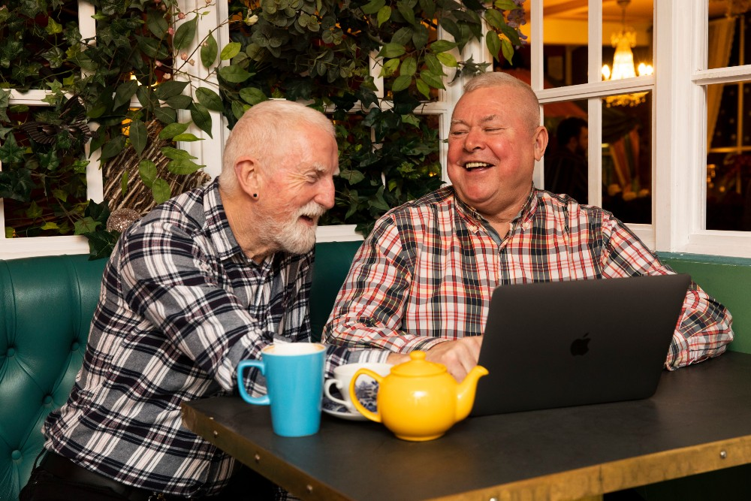
^{How?}
^{A month-long survey}
^{funded by Aberystwyth}
^{University and conducted}
^{online and in-person.}
Notes:
We shared the survey with:
Organisations across Bridgend, Rhondda Cynon Taf and Merthyr Tydfil
Older people’s organisations across Wales
Older people who have previously used ACM for transport service over the last 5 years
Volunteers who have previously provided transport support for ACM service users
People who attended coffee mornings in Gilfach Goch day centre and Cynon Linc community hub
Users of Cynon Linc community hub in Aberdare
We contacted previous or existing users of our transport services either through a face-to-face interaction with one of our support workers or a phone call from a member of Age Connects Morgannwg staff. We had also planned to hold a focus group; however, this didn’t proceed due to a low uptake, despite the incentive of a free St David’s Day afternoon tea.
We also hosted the survey online and encouraged people via our social media channels to take part in the survey.
75 people completed the survey. Of those, 47% had their own transport; 79% lived on a bus route; and 48% regularly used public transport. Of those who didn’t use public transport, the most common reason was they needed assistance to travel. People told us that they had been refused a taxi because they had a guide dog with them as well as being refused a taxi as they could not accommodate their wheelchair. 57% of respondents were aged between 60 and 79 years of age.

Slide 4
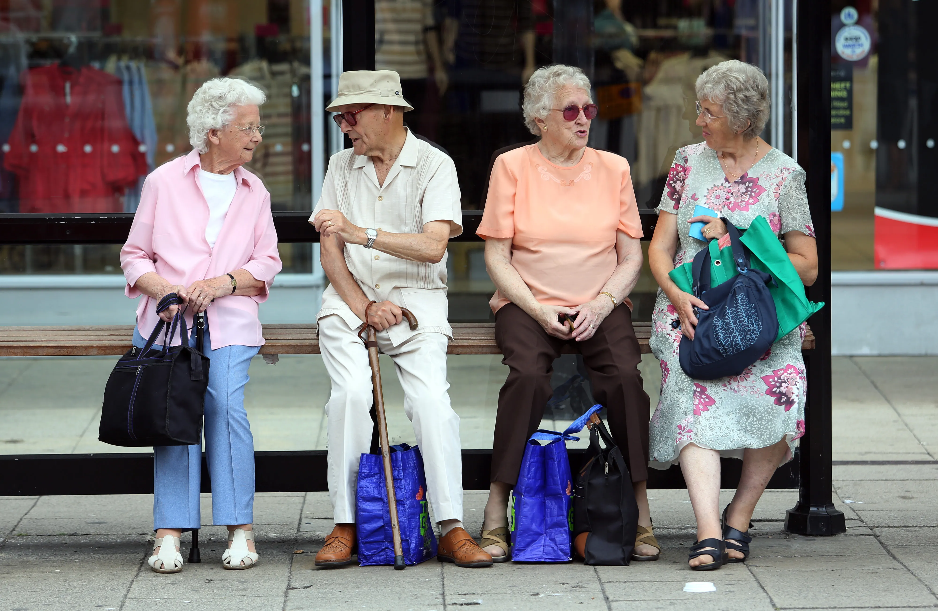
^{Results}
^{We found a real desire to}
^{get out more, but identified}
^{multiple barriers to be}
^{overcome.}
Notes:
Key themes from the survey responses centred on:
1. People have trouble getting out and about or getting to medical appointments due to transport accessibility, times and cost.
For those who told us they don’t use public transport regularly, they told us this was because they needed assistance to travel; bus/train stops were too far away from their home; times weren’t convenient, and the service was too unreliable. In these instances, people told us they relied on a lift from friends or family members, but they often felt guilty for asking or a burden, and they did not like to feel this way.
2. People want to get out, and sometimes want to use public transport more than they do, but they experience barriers to be able to achieve this.
Respondents told us very loudly that getting out and about is important to them – not just to get to a medical appointment, but to get out of the house and connect with their communities. We asked them “What benefits does it bring to your life to use the transport in this way [a transport service provided by Age Connects Morgannwg using staff trained in supporting older people]?”. In a multiple choice option for answers, 55% answered ‘To get me out of the house’; 47% answered ‘To lift my spirits’; 47% answered ‘To socialise’ and 43% answered ‘To feel part of a community.
3. Barriers to public transport include times (either not meeting need or changing due to delays) and lack of accessible provision for those with mobility issues or a disability.
People told us that public transport doesn’t often meet their needs due to a variety of reasons, but often these centred on public transport, and private transport such as taxis, not meeting the needs of people with mobility issues or disability. For some people they struggle to stand outside in the cold waiting for a bus; some people cannot walk up a hill with shopping from the train/bus stop; we heard stories of taxi’s refusing to take assistance dogs; people told us that often they experience difficulty with wheelchair access; we were told that often people can’t rely on public transport to get to appointments as so frequently they are delayed or buses and trains don’t turn up at all – sadly this can be the same with hospital provided transport.
4. Sometimes people would like and need a trained volunteer or support worker to join them on their outing, evidencing that transport often isn’t the only thing that person needs support with
45 people told us they would be happy to pay for a transport service but importantly one with ACM trained staff or volunteers, and on average they said they would be happy to spend £9 an hour for this service.
We also met with Rail Future Wales who highlighted with the upcoming South Wales Metro that some of the trains on the valleys train lines will be swapped to trams in the upcoming future. We believe this will cause barriers for lots of people, including older people, as trams do not have toilets on board.

Slide 5
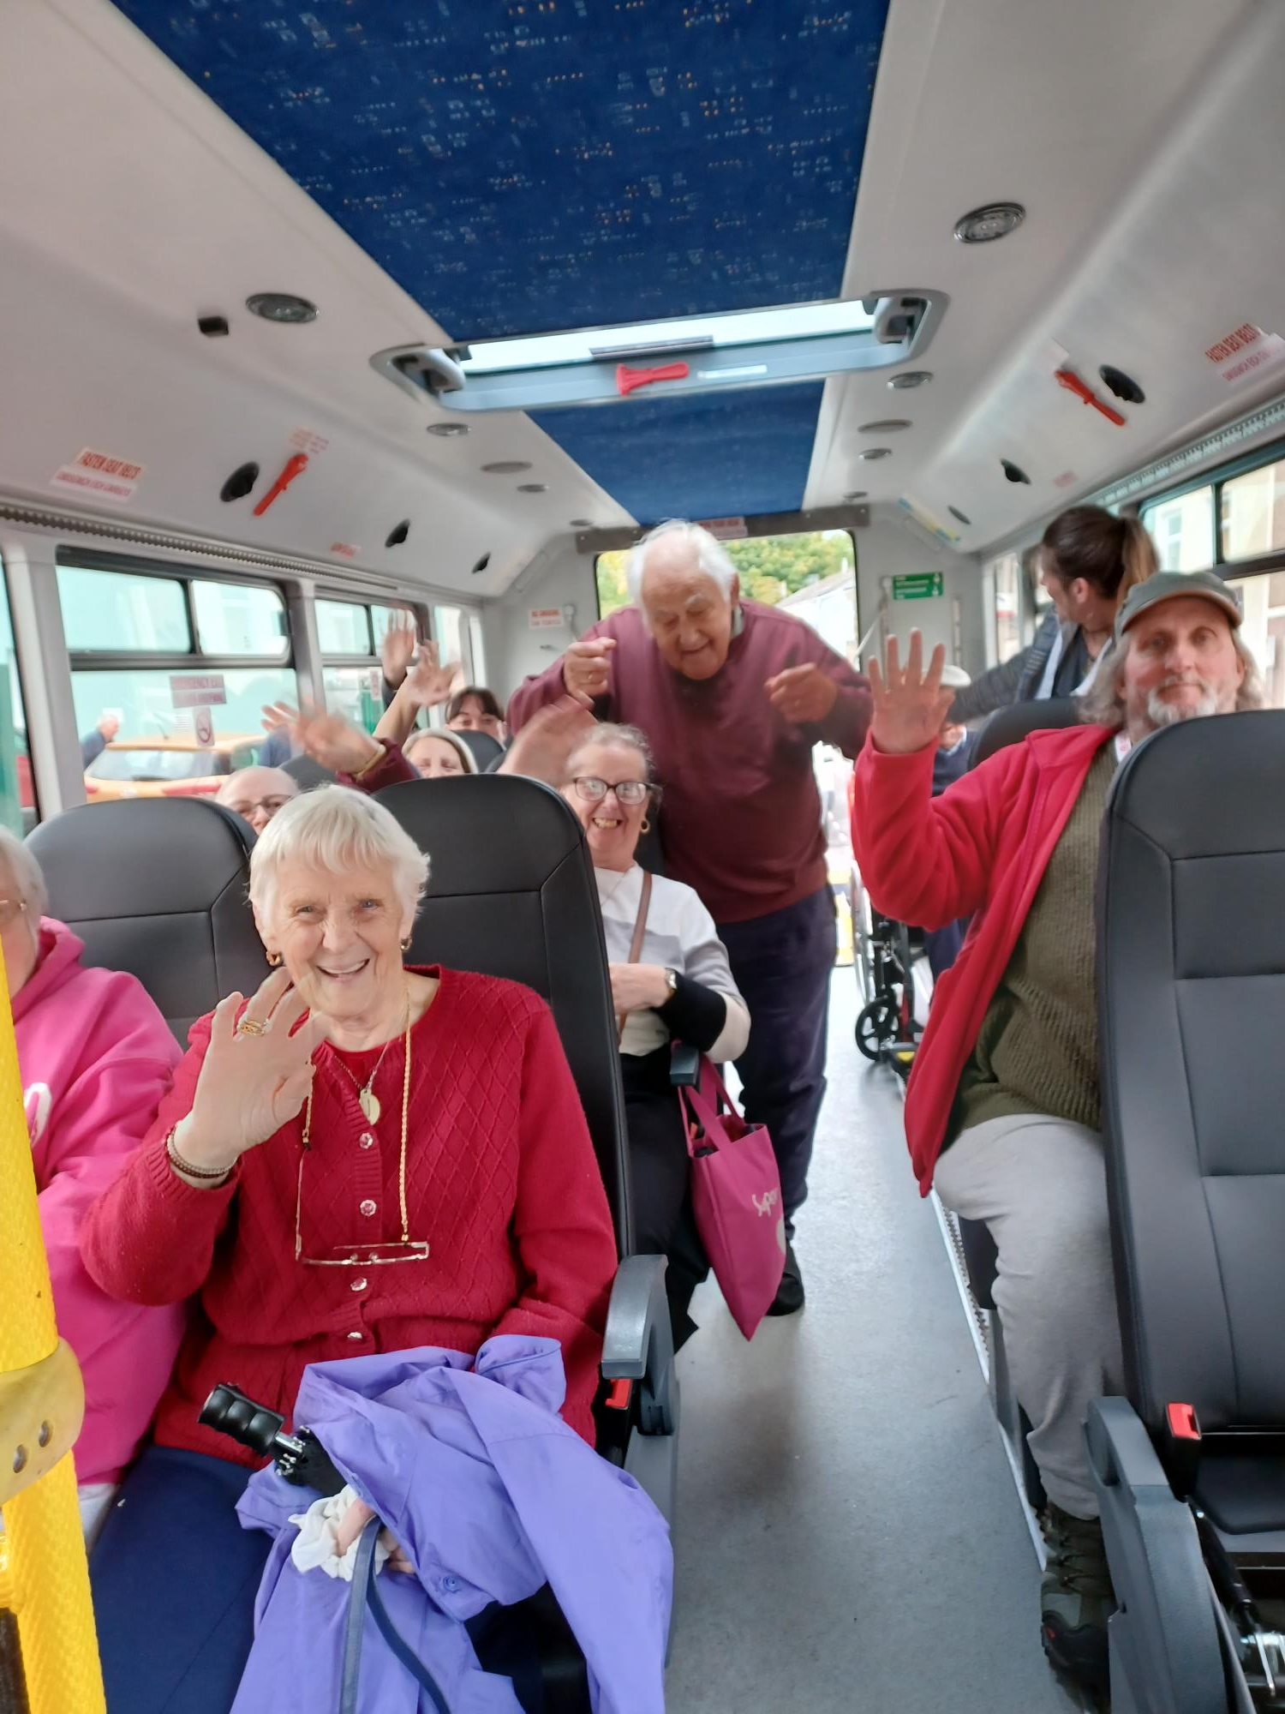
^{Next steps}
Work alongside other organisations and decison
^{makers to deliver a new}
^{transport service.}
Notes:
We will be perfectly honest and as a charity we do not want to be a transport provider, and we also recognise we aren’t the experts in this area and many others are. So we have shared the results with local organisations – both in the third and private sectors in the hope these results can be used to make changes to existing provision. Afterall, we should all strive to meet the needs of those who use, or want to use (but experience barriers) our services.
We met with Lee Waters MS – the deputy Minister within Welsh Gov who had transport in their portfolio. We meet with him to discuss the results. As expected we know the public sector is experiencing significant deficit budget issues, and therefore the funding of a new service, or an uplift to an existing service, is unlikely. However, we spoke a lot about the global view of budgets in Welsh Gov and how transport issues might be negatively impacting other budgets – as an example the health budget with Do Not Attend (DNA) appointments. As a result of the meeting, along with support from the THINK team, we are now looking into the amount of DNA appointments (via a FOI to health boards) to understand better if there is a piece of work that can be done to put a better transport infrastructure in place to save the cost to the NHS in Wales on those who cannot attend appointments due to travel.
This exercise is ongoing but what I can share is across 2 health boards alone (Cwm Taf and Cardiff & Vale) – nearly a quarter of a million appointments were not attended last year alone. Whilst we don’t know the reasons for this we suspect this might be how this workstream is directed in the coming months – will health boards benefit from recording the reasons for DNAs so that we can understand it better and support people to attend? Often we need this information to find out what the barriers are.

Slide 6
^{Get in touch}
^{If you would like to be}
^{Involved or find out more,}
^{please contact me.}
rachel.rowlands@acmorgannwg.org.uk | 07969 758526
Notes:
Key themes from the survey responses centred on:
1. People have trouble getting out and about or getting to medical appointments due to transport accessibility, times and cost.
For those who told us they don’t use public transport regularly, they told us this was because they needed assistance to travel; bus/train stops were too far away from their home; times weren’t convenient, and the service was too unreliable. In these instances, people told us they relied on a lift from friends or family members, but they often felt guilty for asking or a burden, and they did not like to feel this way.
2. People want to get out, and sometimes want to use public transport more than they do, but they experience barriers to be able to achieve this.
Respondents told us very loudly that getting out and about is important to them – not just to get to a medical appointment, but to get out of the house and connect with their communities. We asked them “What benefits does it bring to your life to use the transport in this way [a transport service provided by Age Connects Morgannwg using staff trained in supporting older people]?”. In a multiple choice option for answers, 55% answered ‘To get me out of the house’; 47% answered ‘To lift my spirits’; 47% answered ‘To socialise’ and 43% answered ‘To feel part of a community.
3. Barriers to public transport include times (either not meeting need or changing due to delays) and lack of accessible provision for those with mobility issues or a disability.
People told us that public transport doesn’t often meet their needs due to a variety of reasons, but often these centred on public transport, and private transport such as taxis, not meeting the needs of people with mobility issues or disability. For some people they struggle to stand outside in the cold waiting for a bus; some people cannot walk up a hill with shopping from the train/bus stop; we heard stories of taxi’s refusing to take assistance dogs; people told us that often they experience difficulty with wheelchair access; we were told that often people can’t rely on public transport to get to appointments as so frequently they are delayed or buses and trains don’t turn up at all – sadly this can be the same with hospital provided transport.
4. Sometimes people would like and need a trained volunteer or support worker to join them on their outing, evidencing that transport often isn’t the only thing that person needs support with
45 people told us they would be happy to pay for a transport service but importantly one with ACM trained staff or volunteers, and on average they said they would be happy to spend £9 an hour for this service.
We also met with Rail Future Wales who highlighted with the upcoming South Wales Metro that some of the trains on the valleys train lines will be swapped to trams in the upcoming future. We believe this will cause barriers for lots of people, including older people, as trams do not have toilets on board.

