Slide 1
Collaborative working – the future of leadership
Winter conference 13th December 2023
Ken Perry

Slide 2
In our workshop we will work though four key strategic questions:
What is leadership and how is it different from management?
What does leading beyond your organisation look and feel like?
How do we build collectives to address long term strategic challenges?
How do we recognise different forms of power and mobilise to get results?
What are we going to cover?

Slide 3
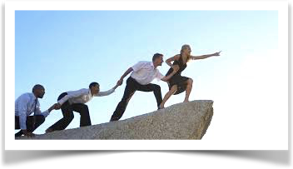
Leadership and management - what’s the difference?

Slide 5
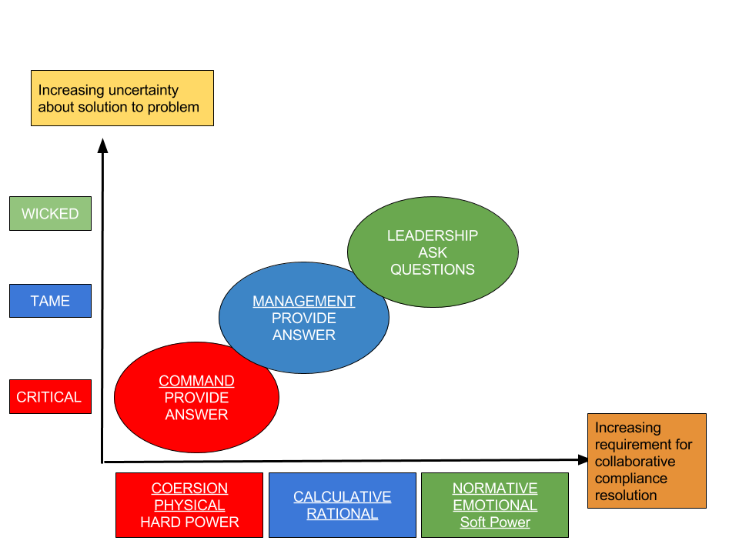
Leadership and management
Professor Keith Grint, Warwick University

Slide 6
What are barriers to working beyond your organisation?

Slide 7
Introducing
systems leadership

Slide 8
The collaborative leadership of a network of people in different places and at different levels in the system, creating a common purpose
Co-operating to make a significant change
Being a host not a hero
Questions to get to common purpose:
What do we want life to be like for people in our place?
Who else needs to be in the room?
What breaks your heart?
Systems Leadership?

Slide 9
The idea behind Systems Leadership is to ask some different questions and work with some different people, to get to a common purpose on which you can co-operate to get real change.
Systems Leadership?

Slide 10
Start with:
Relationships, influence, trust: “Systems move at the speed of trust”
Partial, clumsy and emergent/evolving solutions
Going slow to go fast – allow for dynamic and changing situations
Double-loop learning
Being a host
Don’t start with:
Structures / organisations / processes
Governance / money / whack-a-mole projects
Being a hero
Systems Leadership?

Slide 11
The key thing is to start: don’t wait for everything to be perfect
You only get change by taking action and giving people agency
Myron Rogers’ Maxims: paste these to your wall:
People own what they create
Real change takes place in real work
The people that do the work do the change
Start anywhere but follow it everywhere
Keep connecting the system to itself
The process we use to get to the future determines the future we get

Slide 12
Collective action and understanding power

Slide 13
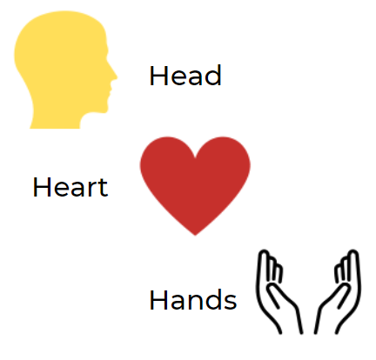
Making change happen

Slide 14
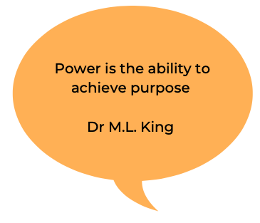
What is power?

Slide 15
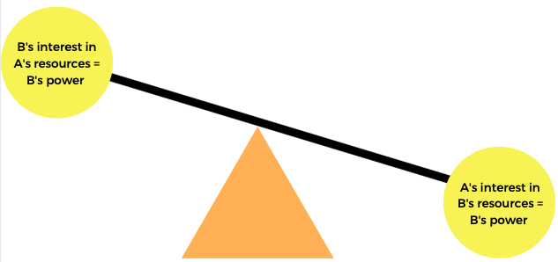
Power is relational

Slide 16
Theory of change – key questions

Slide 17
Working in complexity and across systems requires leadership
Leadership is about building commitment, common purpose and being influential
Systems leadership is a messy team sport with no clear beginning or end – requires stamina & strong relationships
Head – Heart – Hands. We all require different things to act
Power is required to achieve purpose
Power is relational
Power with and power over
We need good hosts more than heroes
Key take aways

Slide 18
Hwyl

