Slide 1
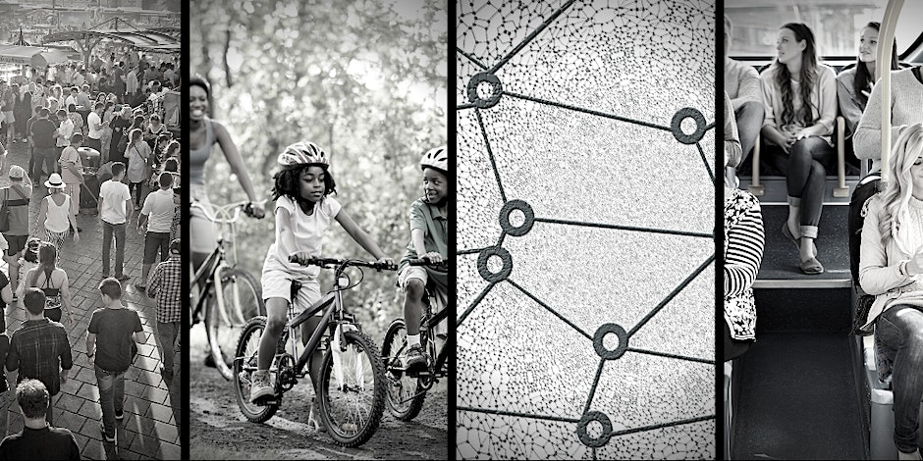
Peace on Our Streets

Slide 2
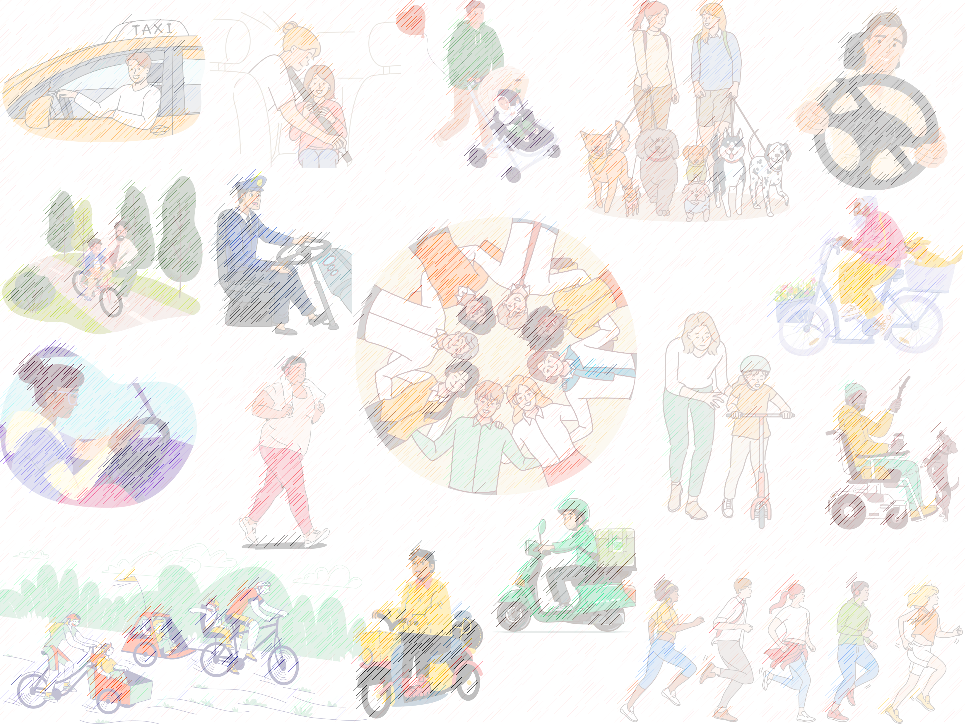
HOW TO DEAL WITH ANGER IN TRAFFIC?

Slide 3
HOW TO DEAL WITH ANGER IN TRAFFIC?
ANGER

Slide 4
HOW TO DEAL WITH ANGER IN TRAFFIC?
ANGER
ANGER EXPRESSION

Slide 5
BE AWARE OF THE SOURCE OF THE STRESS

Slide 6
BE AWARE OF THE SOURCE OF THE STRESS
FOCUS ON YOUR IMPACT

Slide 7
BE AWARE OF THE SOURCE OF THE STRESS
FOCUS ON YOUR IMPACT
REEVALUATE THE SITUATION

Slide 8
BE AWARE OF THE SOURCE OF THE STRESS
FOCUS ON YOUR IMPACT
REEVALUATE THE SITUATION
RELEASE & MOVE ON

Slide 9
BE AWARE OF THE SOURCE OF THE STRESS
FOCUS ON YOUR IMPACT
REEVALUATE THE SITUATION
RELEASE & MOVE ON
BRING YOUR BODY BACK TO BALANCE

Slide 10
BE AWARE OF THE SOURCE OF THE STRESS
FOCUS ON YOUR IMPACT
REEVALUATE THE SITUATION
RELEASE & MOVE ON
BRING YOUR BODY BACK TO BALANCE
PUT ON A HAPPY FACE

Slide 11
BE AWARE OF THE SOURCE OF THE STRESS
FOCUS ON YOUR IMPACT
REEVALUATE THE SITUATION
RELEASE & MOVE ON
BRING YOUR BODY BACK TO BALANCE
PUT ON A HAPPY FACE
LISTEN CALMING MUSIC

Slide 12
BE AWARE OF THE SOURCE OF THE STRESS
FOCUS ON YOUR IMPACT
REEVALUATE THE SITUATION
RELEASE & MOVE ON
BRING YOUR BODY BACK TO BALANCE
PUT ON A HAPPY FACE
LISTEN CALMING MUSIC
IMPROVE YOUR TIME MANAGEMENT

Slide 13
BE AWARE OF THE SOURCE OF THE STRESS
FOCUS ON YOUR IMPACT
REEVALUATE THE SITUATION
RELEASE & MOVE ON
BRING YOUR BODY BACK TO BALANCE
PUT ON A HAPPY FACE
LISTEN CALMING MUSIC
IMPROVE YOUR TIME MANAGEMENT
BE YOUR OWN GUIDE

Slide 14
BE AWARE OF THE SOURCE OF THE STRESS
FOCUS ON YOUR IMPACT
REEVALUATE THE SITUATION
RELEASE & MOVE ON
BRING YOUR BODY BACK TO BALANCE
PUT ON A HAPPY FACE
LISTEN CALMING MUSIC
IMPROVE YOUR TIME MANAGEMENT
BE YOUR OWN GUIDE
DECREASE YOUR STRESS IN GENERAL

