Slide 1
Motonormativity
Ian Walker
Swansea University
Alan Tapp and Adrian Davis
University of the West of England

Slide 2
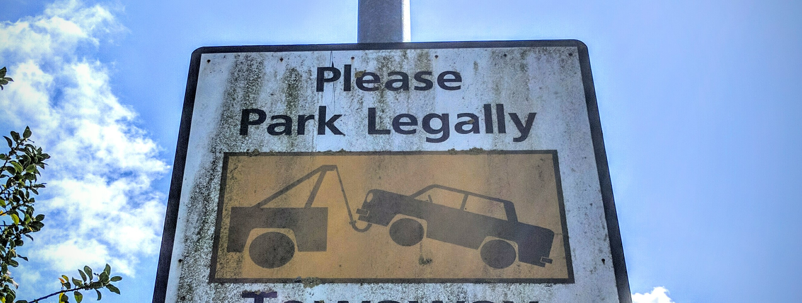
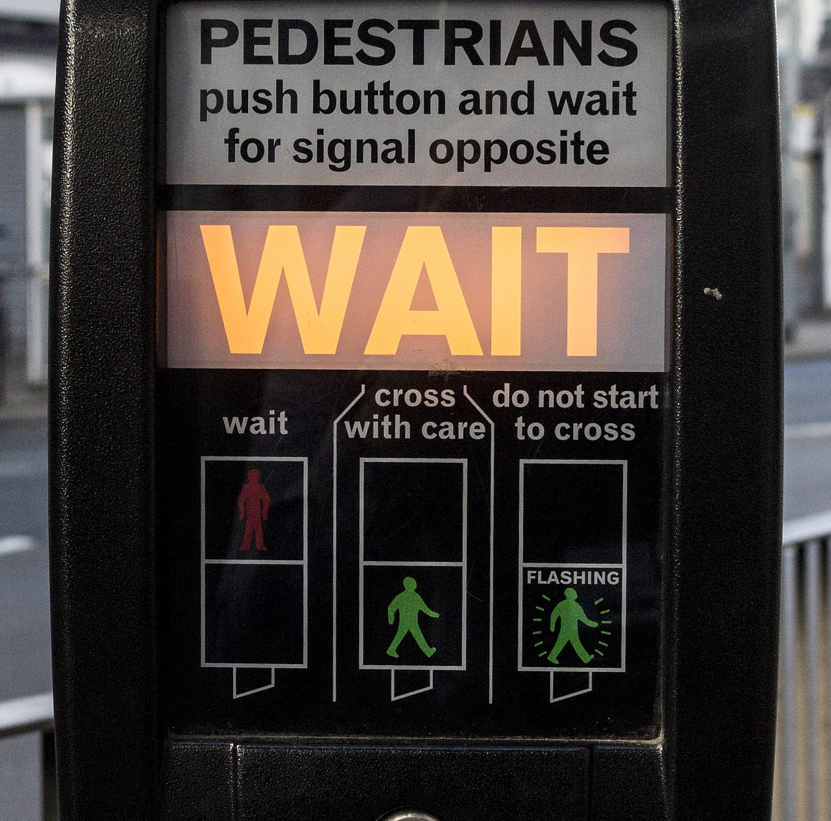
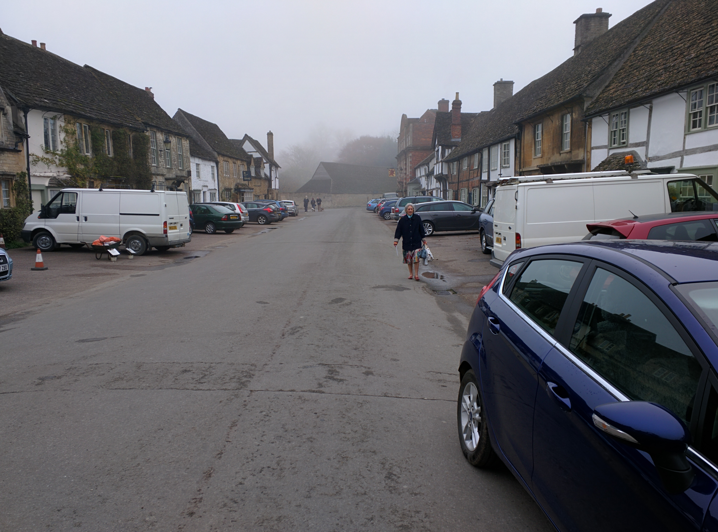
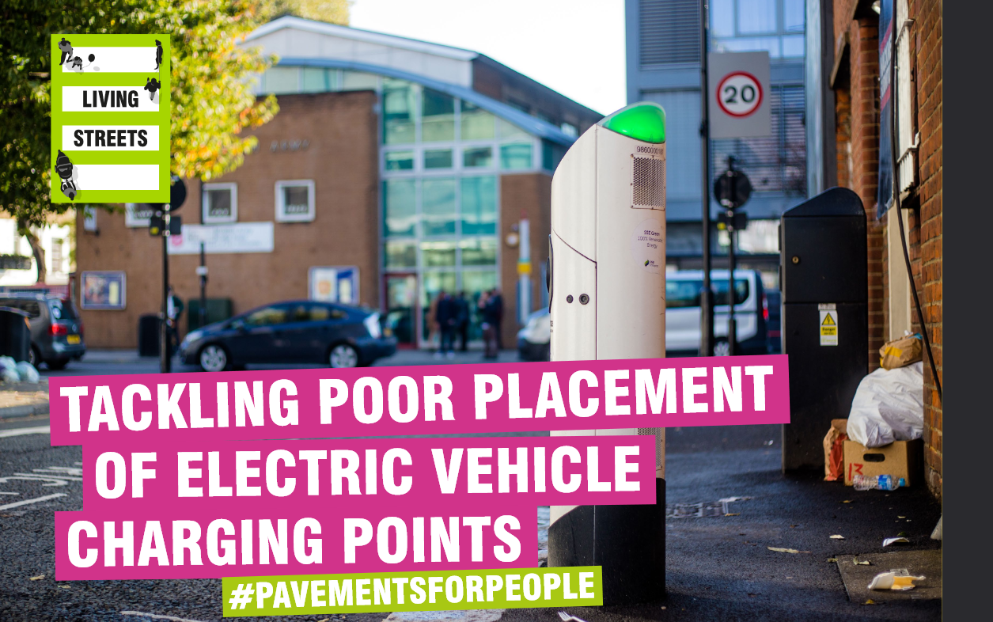
Motonormativity in policy and practice

Slide 3
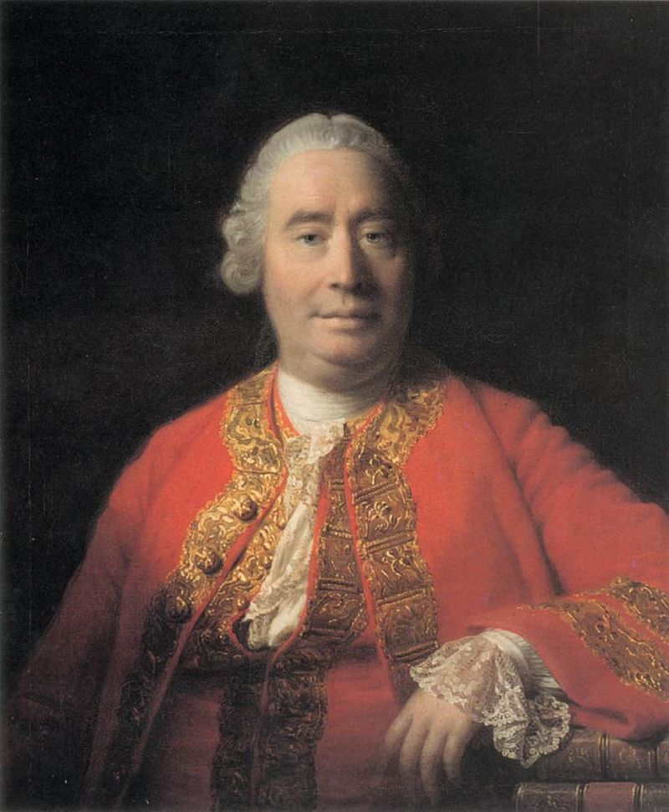
The Is-Ought Problem
(David Hume, 1739)

Slide 4
Double standards?
A cultural blind spot about the negatives of motoring
Lack of ambition to tackle law-breaking or pollution
Death and injury constructed as unavoidable
Cars are never “grounded” until lessons from crash investigation can be implemented!

Slide 5
Double standards?
Original plan:
“Is it acceptable to put another person’s life in danger if that makes things more convenient for you?”
“Is it the country’s job to support people’s lifestyle choices?”
“Is it acceptable to barge in front of another person?”
“Should the state help people live beyond their means?”
“Should people who operate dangerous machinery in public be liable for any consequences?”

Slide 6
Double standards?
Final approach: change single words
“People shouldn’t drive in highly populated areas where other people have to breathe in the car fumes”
“People shouldn’t smoke in highly populated areas where other people have to breathe in the cigarette fumes”

Slide 7
If somebody leaves their car/belongings in the street...

Slide 8
Risk is a natural part of driving/working...

Slide 9
It’s okay for a delivery driver/chef to cut corners with safety...

Slide 10
There’s no point expecting people to drive/drink less...

Slide 11
People shouldn’t drive/smoke...where other people have to breathe in the car/cigarette fumes

Slide 12
Drivers and non-drivers responded essentially the same

Slide 13
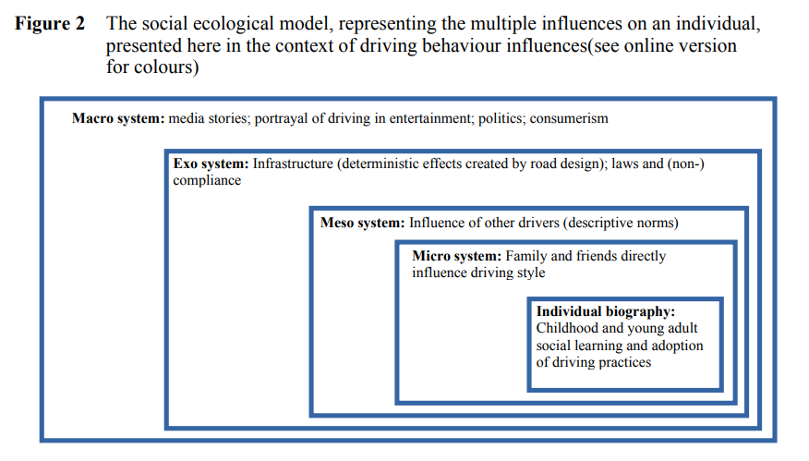
We are products of our environments?

Slide 14
Our central claim is that lifelong exposure to an environment where motoring is prioritised, and where the harms of motoring are systematically downplayed, leads people not only to see this as normal, but also to see it as proper.

Slide 15
Implications
This is a form of unconscious bias, and should be recognised as such
Decision-makers and planners could audit their decisions and implement processes to counter their biases
Change is most effective if it starts large (laws, infrastructure) and influences individuals later

Slide 16
Thank you
drianwalker.com
@ianwalker

