Slide 1
Transport and Health Integrated research NetworK

Slide 2
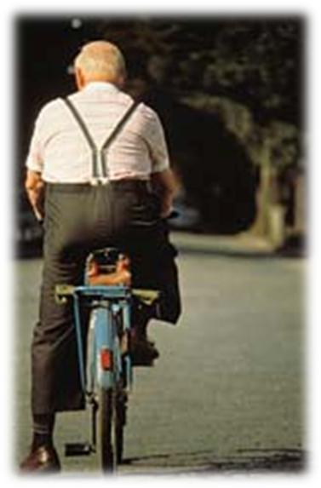
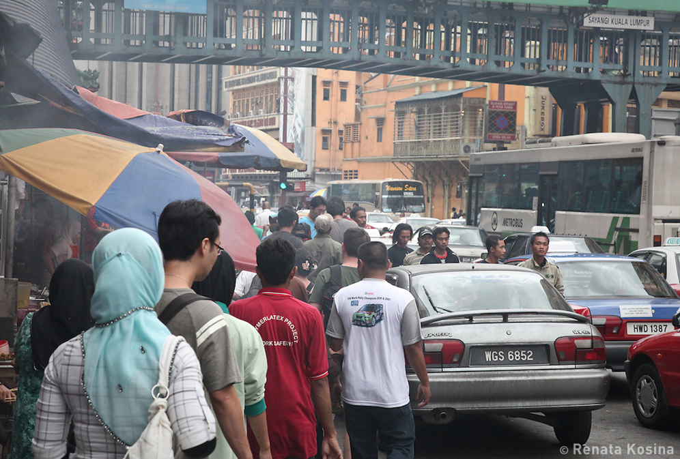
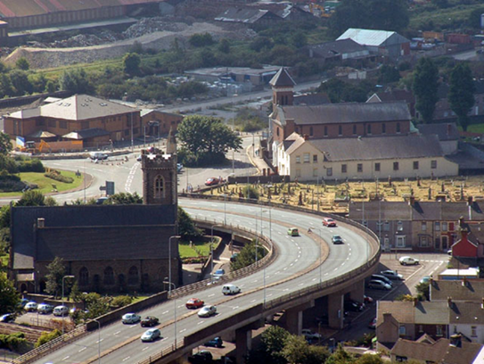
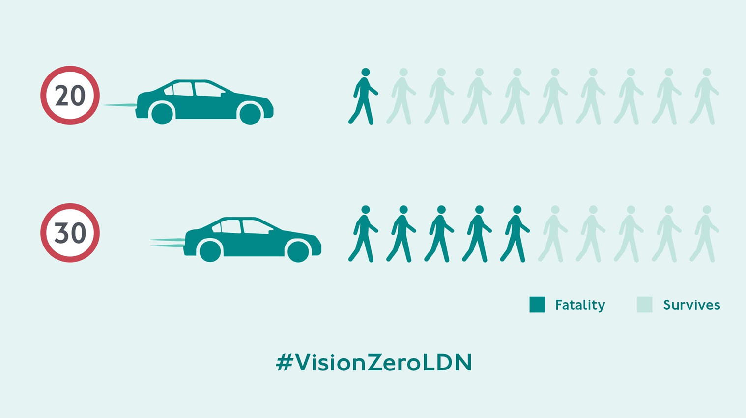
All cause mortality reduced 20%
Cardiovascular disease by 30%
Reduce high blood pressure
and stroke
Mental health improvements
Low levels in UK of active travel
Obesogenic environments
Pollution
Reduction in active Travel
Vehicles still high level of pollutants
Research indicates 8.8m early
deaths each year worldwide
Direct health consequences
e.g. asthma, emphysema, lung cancer
Narrows arteries and
Weakens muscles
Stroke and dementia link.
153,000 casualties in UK/year
Big improvements in numbers
But mostly for vehicle occupants
Vulnerable road uses –
walking/cycling - still high
Older pedestrians & young drivers
Those living in areas of high deprivation
Car dependency
Isolation and loneliness
Low social capital and support
High deprivation=more main roads
Health and wellbeing impacts
Road traffic casualties and injuries
Community severance

Slide 3
Public involvement and engagement
Public Agenda Setting Workshops
THINK Participate
Secondments opportunities (3)
The Network Stakeholder Agenda Setting Workshops
Public Workshops
N=180 network stakeholders
The THINK Foundry
Communities of Practice Hubs (4)
Evidence-based reviews (5)
Funded Research Development Groups (6)
Training (2)
Unfunded Research Development Activity (6)
Podcasts (5)
Conference (2) and seminars (6)
Blogs (12)
Outputs
Journal articles (15)
Research bids (15)
New research projects (6)

Slide 4
THINK Participate
To generate more professional and the general public understanding the relationships between transport and health (growing the network).
Secondments opportunities
a researcher placed within Rural Health and Care Wales,
a data scientist placed within Sustrans
health economist to be placed in Age Connect Morgannwg
Public involvement and engagement
Public Agenda Setting Workshops
Public transport – reduce cost, more services, better access, better public image
Active travel – more segregated bicycle lanes, more traffic free areas, space sharing issues.
Transport justice – accessibility for all, reducing private car ownership
The Network Stakeholder Agenda Setting Workshops
Transport should be equitable and inclusive,
Increasing opportunities to collaborate and improving collaboration as a practice
Raising awareness of the impact of transport on health
Identifying research opportunities, increasing and standardising data collection, and improving tools for decision-making.
Public Workshops
Running workshops with the public on transport and health issues during 2023/24

Slide 5
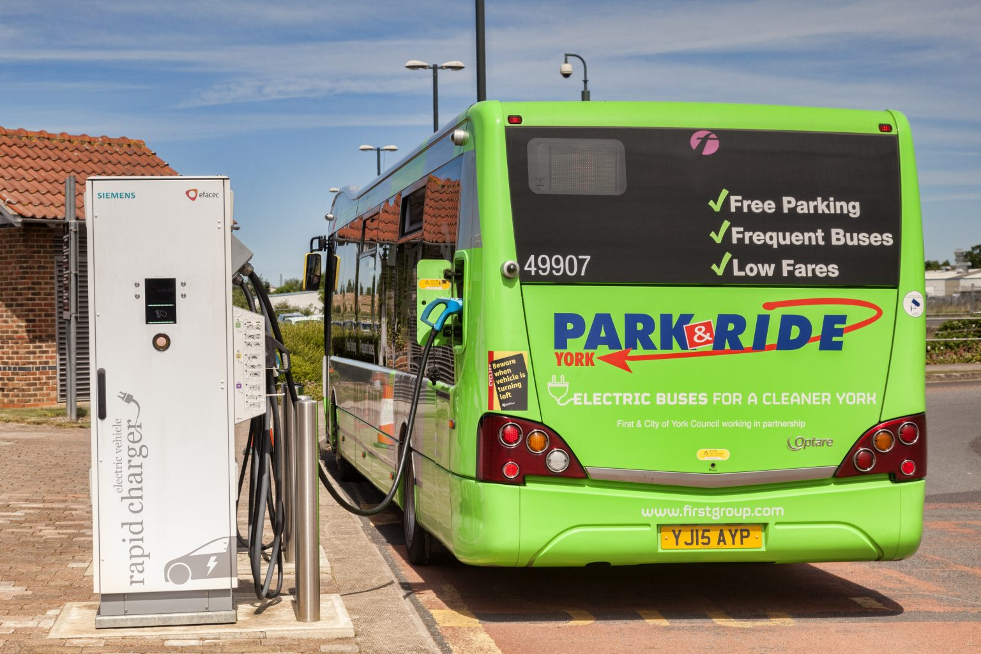
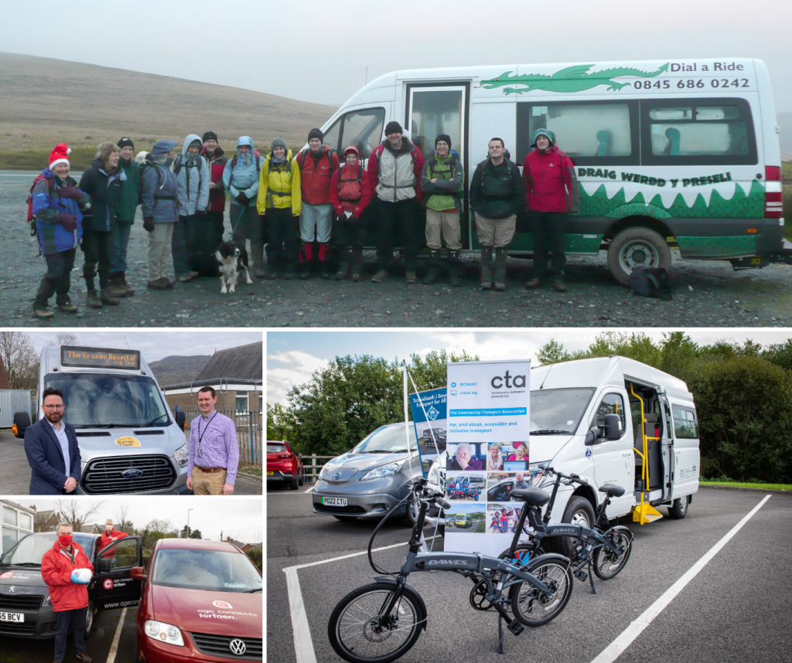
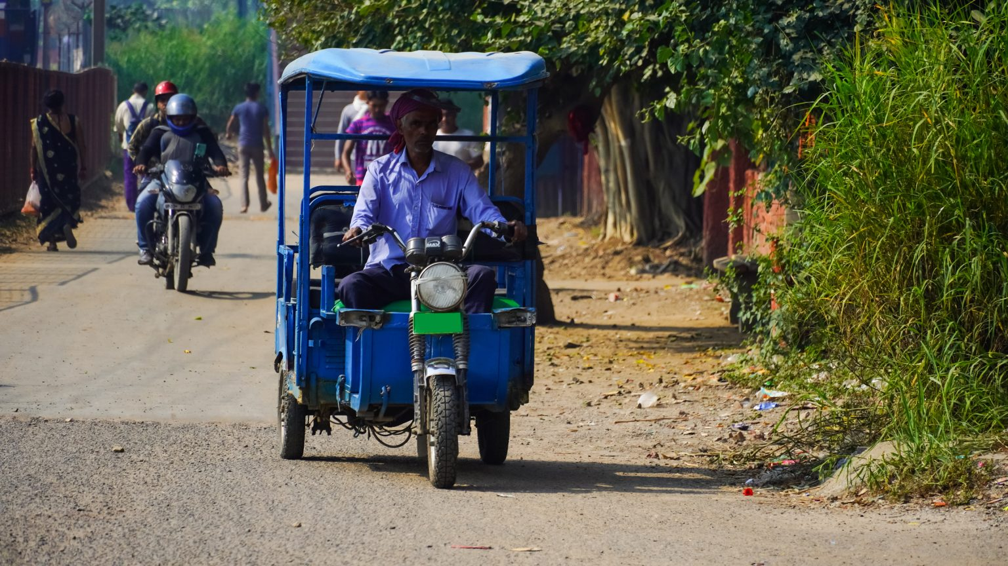
The THINK Foundry
To generate new knowledge in transport and health (enriching the network).
Funded Research Development Groups:
Increasing Mobility of Young Women by Giving Scooties Led Dr. Nashia Ajaz, Lecturer- Gender Studies at Fatima Jinnah Women University, Pakistan.
Social inclusion through community-led transport. Led by Gemma Lelliott, Director for Wales, Community Transport Association (CTA).
Age Connects Morgannwg: Transport Research. Led by Bethan Shoemark-Spear, Strategic Development, Partnership and Policy Manager for Age Connects Morgannwg
Encouraging Active Travel In Newtown. Led by Ruth Stafford, Project Officer, Mid Wales. Sustrans
Community Transport Initiatives – Supporting Volunteer Drivers. Led by Rhian Hathaway, Bridges Centre and Andrea Charles, Community Wellbeing Project Manager.
Exploring prospects of shared e-micro mobility in Rural India. Led by Dr. Anshuman Sharma, Assistant Professor and Indian Institute of Technology (BHU) and Dr Yasir Ali, Lecturer, Transport and Urban Planning Group, School of Architecture, Building and Civil Engineering, Loughborough University
Exploring a Future Six Councils Community Electric Bus and Bikes. Led by Kate Inglis, Community Councillor on Llangattock Community Council

Slide 6
To increase knowledge and skills in transport and health (enhancing the network).
Conference and seminars:
November 2023: Cycling in the Workplace 2023 October 2023: Public transport resilience to climate change in the UK
April 2023: Gig Economy, logistics, health and wellbeing
January 2023: Spaces for Play
December 2022: Gender + Bus project
June 2022: hosted International Conference on Transport and Health.

Slide 7
To increase knowledge and skills in transport and health (enhancing the network).

Slide 8
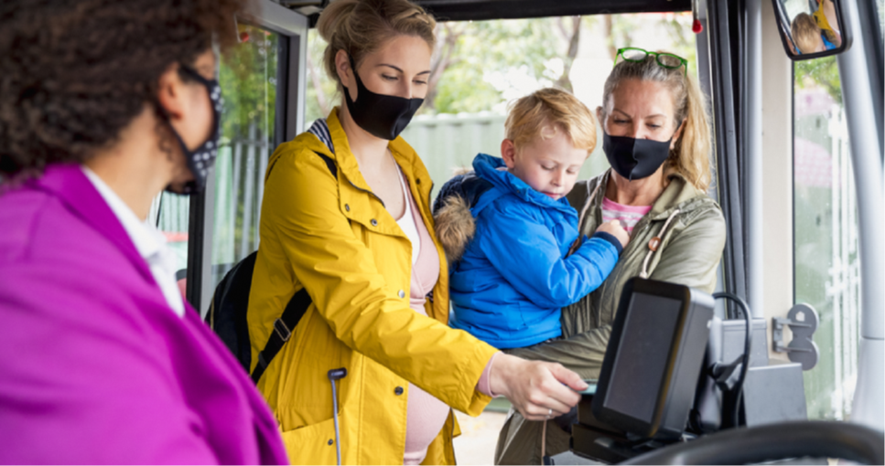
Examples of our work at THINK

Slide 9
Thank you! Please do get involved!
https://think.aber.ac.uk/get-involved/
THINK – the Transport and Health Integrated Research Network
Psychology Department, Aberystwyth University.
THINK@Aber.ac.uk
@transporthealth
https://think.aber.ac.uk/

