Slide 1
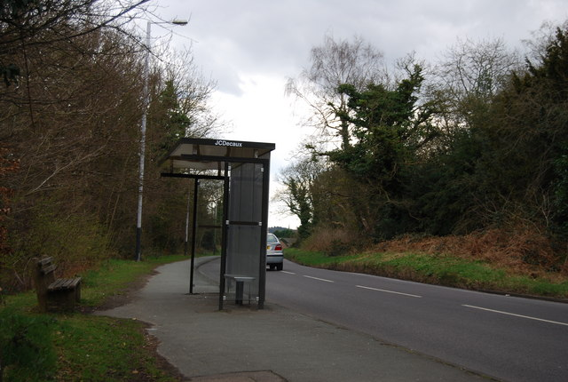
Transport equity, culture and ‘culture wars’
Judith Green
Wellcome Centre for Cultures & Environments of Health
University of Exeter

Slide 2
Tackling transport systems designed around private cars is essential for:
[picture of busy major road]
Transport equity
Health equity
Environmental equity
A triple win?

Slide 3
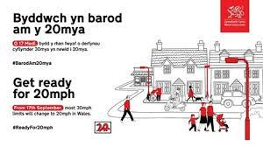
Policies to decarbonise transport recruited in ‘culture wars’
PHOTO of Rishi Sunak, with the Sun newspaper’s ‘Give us a Brake’ logo at top right
Photo of person cycling over traffic calming measures between planters at entry to residential street
[

Slide 4
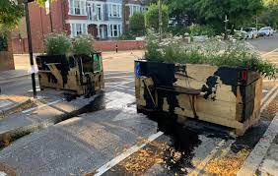
Opposition: what is going on?
Photo of ULEZ camera pole fallen over, and camera covered with ‘NO ULEZ’ hood
PHOTO of protesters outside County Hall with yellow placards including ‘Keep Oxford Free No to 15 minute city’ and ‘LTNs cause massive gridlock and pollution’
Images: bottom left via @RachelMantell on X, July 2022; right Emily Kerr via road.cc

Slide 5
New infrastructure intervenes in a system, with multiple, and unintended, consequences
Reduce car access
Increase cycling and walking
Fitter, more able travel more quickly
Restrict access for trade; visitors
Reduce private car use
Increase use of delivery services
Divert traffic to major roads
Longer public transport journeys; more expensive taxis

Slide 6
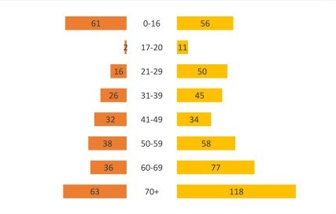
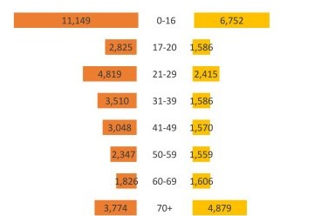
Example: Male and female pedestrians injured 2005-2015 in collisions with:
PEDAL CYCLE
MOTOR CAR

Slide 7
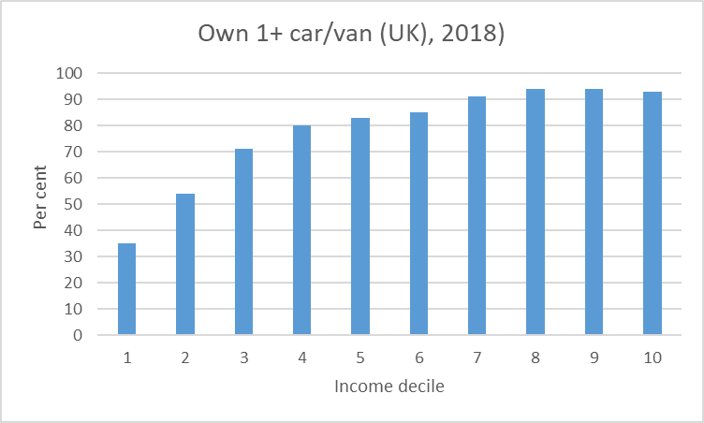
Mode ‘choice’ in UK still socioeconomically patterned
Most economically disadvantaged quintile make:
More walking trips
Fewer car trips
Around 3 x number of bus trips than most advantaged (outside London)
(NTS data)

Slide 8
Cycling as ‘unthinkable’
I wouldn’t be seen dead on a bike… you’d never live it down!(Young adult, Belfast, Northern Ireland)
It’s an hour by bus, up hills and its always raining: there is no way you could cycle (Welsh rural college student)
When you’ve made it, you buy a car not a bicycle (Black Londoner, England)
Interviewer: Does anyone here cycle?
Responses: [general laughter] That’s a ridiculous question! (Group of Asian-heritage women, London)

Slide 9
Case study: cycling achieved and not
Two women from cycle training courses, proud of new skill and keen to take up cycling for transport
6 months later: Rosalind, in suburban London, had opportunities to move from leisure cycling in park, to build confidence on roads; Candy, in inner London, was thwarted.
“I practised with the ‘cycling ladies’ in the park” (Rosalind)
“Round my area there’s a lot of kids who take over the park and I don’t want to be the adult trying to learn how to ride a bike, you know what I mean? It’s all these factors, no I’ll go on a bus instead” (Candy)

Slide 10
Conclusions
Policies intervene in complex systems: effects are multiple
Mobility systems are inequitable – but changes can increase inequities
Accept trade-offs, rather than assume a ‘win-win-win’
Mobility cultures are crucial part of local mobility systems. We need to take these into account to:
Assess likely equity implications of changes
Offset the risk of bad faith actors undermining efforts in ‘culture wars’

