Slide 1
Support with early post-driving-test mobility Shaun Helman
22/02/2024

Slide 2
Contents
Context
Some thoughts on driver skill
Risk factors for young and novice drivers
What works
Better licensing

Slide 3
Context

Slide 4
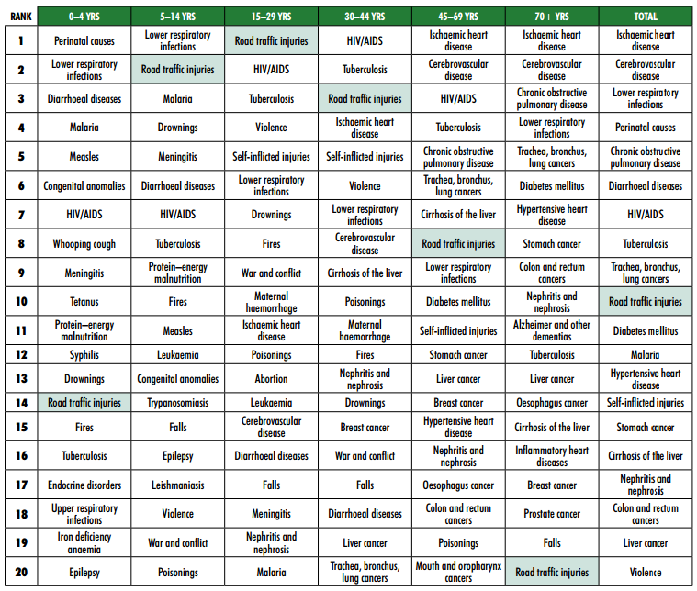
Source: WHO (2008), Global Burden of Disease: 2004 update, cited in:
Global status report on road safety: time for action. Geneva, World Health Organization, 2009 (Global Status Report on Road Safety - Time for Action | WHO | Regional Office for Africa).

Slide 5
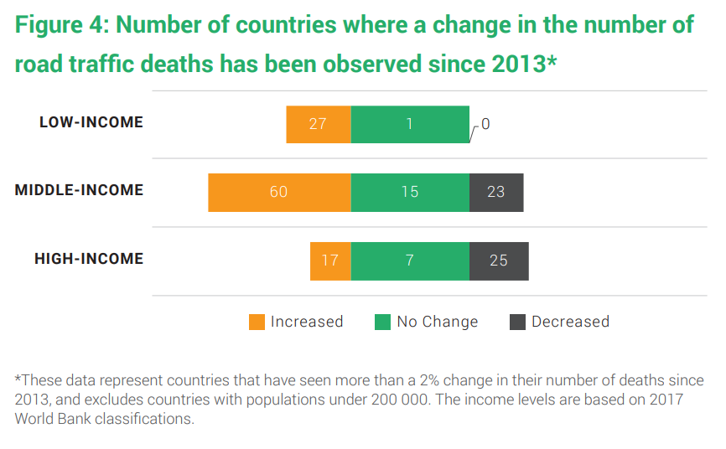
https://www.who.int/publications/i/item/9789241565684

Slide 6
Driver skill

Slide 7
Skill and the driving test
UK practical driving test
2007-2022 average pass rates
Men = 50%
Women = 43.6%
2012-2021 average KSI casualties per year (car drivers) 17-24
Men = 2,540
Women = 1,173
drt0201.ods (live.com)
ras0501.ods (live.com)

Slide 8
Risk factors – young and novice drivers

Slide 9
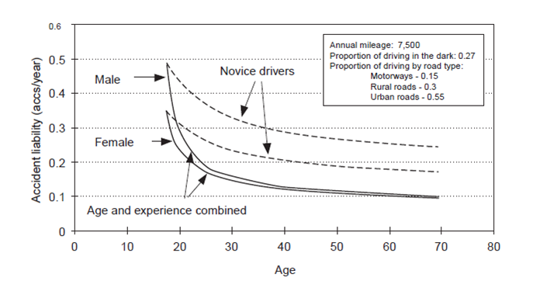
Age and inexperience
Young and novice drivers are over-represented in collisions
Both age and experience is a factor – this has long been established²⁻⁷

Slide 10
Specific situations post-test
Driving with passengers and at night are both higher risk for new drivers^{8,9}

Slide 11
What works?

Slide 12
What about education and training?
“The only direct benefits imparted by broad driver education and training would appear to be the basic vehicle control skills and knowledge of road rules necessary for entering the driving population. According to the evidence it has no measurable direct effect on collision risk, and its continued use should therefore be set against much lower expectations in terms of what it can contribute directly to the safety of new drivers.”¹⁰

Slide 13
What about education and training?
Unintended consequences
Early licensure¹¹
Training ‘done wrong’¹²
Lack of progress in adopting more comprehensive approaches

Slide 14
Things that reduce collisions: what the evidence tells us
Age | Experience | Risky situations
Minimum learning periods¹³ | Minimum learning hours^{13,14} (Hazard perception testing^{2,15}) | Controls on unsupervised driving at night¹⁶⁻²⁰ Controls on unsupervised driving with peer-age passengers^{16,19,21}
What about counterarguments?
https://www.trl.co.uk/publications/supporting-new-drivers-in-great-britain²²

Slide 15
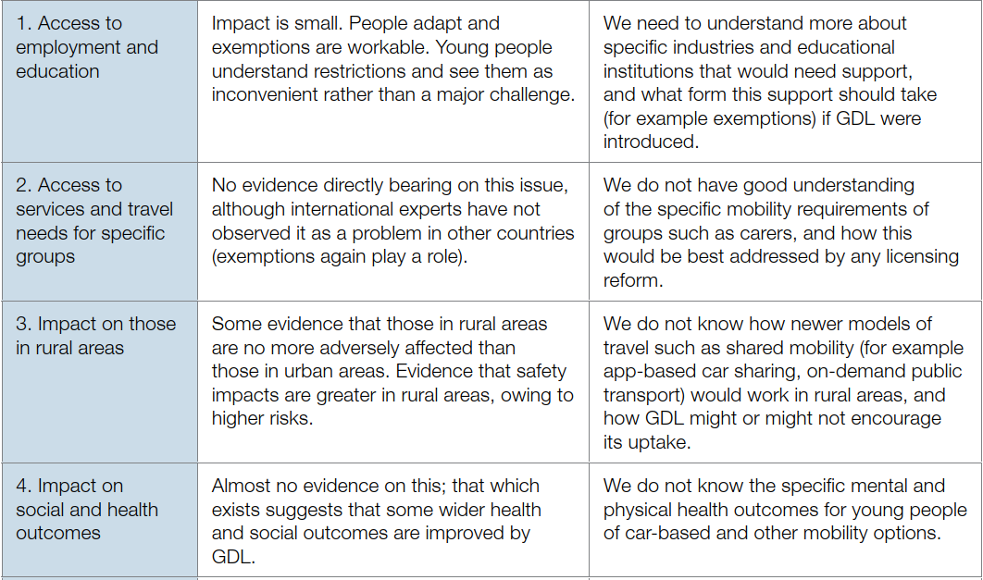

Slide 16
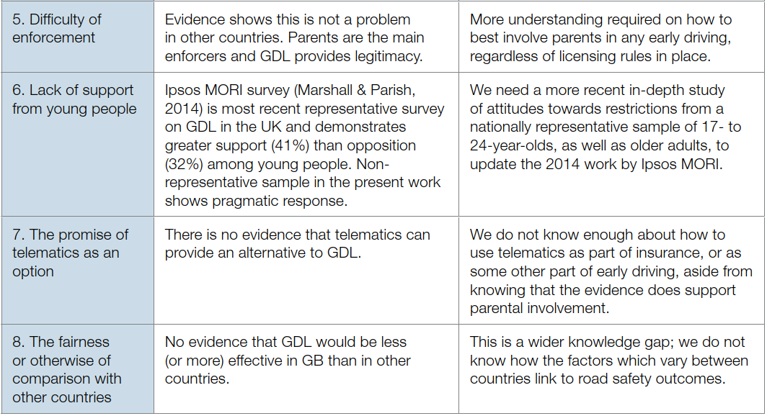

Slide 17
References
Williams, A. F. & O'Neill, B. (1974). On-the-road driving records of licensed race drivers. Accident Analysis and Prevention, 6, 263–270, cited in Evans, L. (2004). Traffic safety.
Wells., P., Tong, S., Sexton, B., Grayson, G. & Jones, E. (2008). Cohort II: a study of learner and new drivers. Volume 1: main report. Road Safety Research Report No. 81. London: Department for Transport​
Mayhew, D. R., Simpson, H. M. & Pak, A. (2003). Changes in collision rates among novice drivers during the first months of driving. Accident Analysis and Prevention, 35(5), 683-691.​
McCartt, A. T., Shabanova, V. I. & Leaf, W. A. (2003). Driving experience, crashes and traffic citations of teenage beginning drivers. Accident Analysis and Prevention, 35, 311–320.​
Sagberg, F. (1998). Month-by-month changes in accident risk among novice drivers. Paper presented at the 24th International Congress of Applied Psychology, San Francisco, August 9–14.​
Forsyth, E., Maycock, G. & Sexton, B. (1995). Cohort study of learner and novice drivers. Part 3: Accidents, offences and driving experience in the first three years of driving. Crowthorne: Transport Research Laboratory.​
Maycock, G., Lockwood, C. R. & Lester, J. (1991). The accident liability of car drivers (RR315). Crowthorne: Transport and Road Research Laboratory.​
DfT (2018). Young Car Drivers Road Safety Factsheet. London: Department for Transport. Retrieved 10 February 2022 from https://assets.publishing.service.gov.uk/government/uploads/system/uploads/attachment_data/file/706516/young-car-drivers-factsheet.pdf
Ouimet, M.C., Pradhan, A.K., Brooks-Russell, A., Ehsani, J.P., Berbiche, D. & Simons-Morton, B.G. (2015). Young drivers and their passengers: a systematic review of epidemiological studies on crash risk. Journal of Adolescent Health, 57(1), S24-S35.

Slide 18
References
Helman, S., Grayson, G. B., & Parkes, A. M. (2010). How can we produce safer new drivers. TRL Report. INS05: Crowthorne: Transport Research Laboratory. P8.
Lewis-Evans, B. (2010). Crash involvement during the different phases of the New Zealand Graduated Driver Licensing System (GDLS). Journal of safety research, 41(4), 359-365.
Katila, A., Keskinen, E., Hatakka, M. & Laapotti, S. (1996). Skid training for novice drivers—benefit for adults, pitfall for youngsters. Paper presented at the International Conference of Traffic and Transport Psychology, Valencia, Spain.
Senserrick, T. & Williams, A. F. (2015). Summary of literature of the effective components of graduated driver licensing systems. Report No. AP-R476/15. Sydney: Austroads.
Gregersen, N. P., Berg, H., Engström, I., Nolén, S., Nyberg, A. & Rimmö, P. (2000). Sixteen years age limit for learner drivers in Sweden: An evaluation of safety effects. Accident Analysis & Prevention, 32, 25-35.
Boufous, S., Ivers, R., Senserrick, T., & Stevenson, M. (2011). Attempts at the practical on-road driving test and the hazard perception test and the risk of traffic crashes in young drivers. Traffic injury prevention, 12(5), 475-482.
Williams, A. F., Ali, B. & Shults, R. A. (2010). The contribution of fatal crashes involving teens transporting teens. Traffic Injury Prevention, 11, 567-572.
Fell, J. C., Todd, M. & Voas, R. B. (2011). A national evaluation of the nighttime and passenger restriction components of graduated driver licensing. Journal of Safety Research, 42, 283-290.
Masten, S. V., Foss, R. D. & Marshall, S. W. (2013). Graduated driver licensing program component calibrations and their association with fatal crash involvement. Accident Analysis & Prevention, 57, 105-113.

Slide 19
References
McCartt, A. T., Teoh, E. R., Fields, M., Braitman, K. A. & Hellinga, L. A. (2010). Graduated licensing laws and fatal crashes of teenage drivers: a national study. Traffic Injury Prevention, 11, 240-248.
Trempel, R. E. (2009). Graduated driver licensing laws and insurance collision claim frequencies of teenage drivers. Arlington VA: Highway Loss Data Institute.
Begg, D. & Stephenson, S. (2003). Graduated driver licensing: the New Zealand experience. Journal of Safety Research, 34, 99-105.
Helman, S., Kinnear, N., Hitchings, J., & Jones, S. (2022). Supporting New Drivers in Great Britain (XPR114). London: RAC Foundation.

Slide 20
Questions?
Dr Shaun Helman
Chief Scientist
shelman@trl.co.uk | www.linkedin.com/in/shaunhelman
+44 [0]1344 770 650 |
TRL | Crowthorne House | Nine Mile Ride | Wokingham
Berkshire | RG40 3GA | United Kingdom

